Slide 1
DEVOPS FINAL CAPSTONE PRESENTATION
BugBoard
— Automated Bug Tracking & Code Analysis
Ayush Kumar Ptra · Scaler School of Technology

Slide 2



CASE NO. PL - 0426
THE PROBLEM
Production bugs are expensive because evidence arrives too late
10x–100x
Late evidence
BugBoard
Production fixes can cost 10x–100x more than catching issues early.
Manual triage lacks direct codebase evidence linking bugs to root causes.
Source inspection, evidence-backed tickets, deterministic analysis, and deployment safety move together.
PROJECT LEDGER
PUBLIC INTEREST REPORT
02 / 08

Slide 3
CASE NO. PL - 0426
THE PIPELINE
One pipeline moves code from commit to monitored deployment
01
02
03
04
Write code
Test & scan
Containerize & deploy
Monitor
Git + React + FastAPI
Pytest + Trivy
Prometheus + Grafana
Docker + Helm + Kubernetes
Passing images publish with immutable SHA tags; Helm deploys two-replica services with live dashboards.
PROJECT LEDGER
PUBLIC INTEREST REPORT
03 / 08

Slide 4
CASE NO. PL - 0426
ARCHITECTURE
Every technology choice favors production readiness
Kubernetes + Helm
FastAPI + React
Self-healing pods, rolling updates, declarative scaling over standalone Docker or EC2.
Decoupled services that scale and deploy independently.
PostgreSQL + Alembic
Prometheus + Grafana
Relational consistency and trackable schema migrations.
Real-time telemetry instead of reactive log reading.
“Every technology choice was driven by production-readiness, not convenience.”
PROJECT LEDGER
PUBLIC INTEREST REPORT
04 / 08

Slide 5
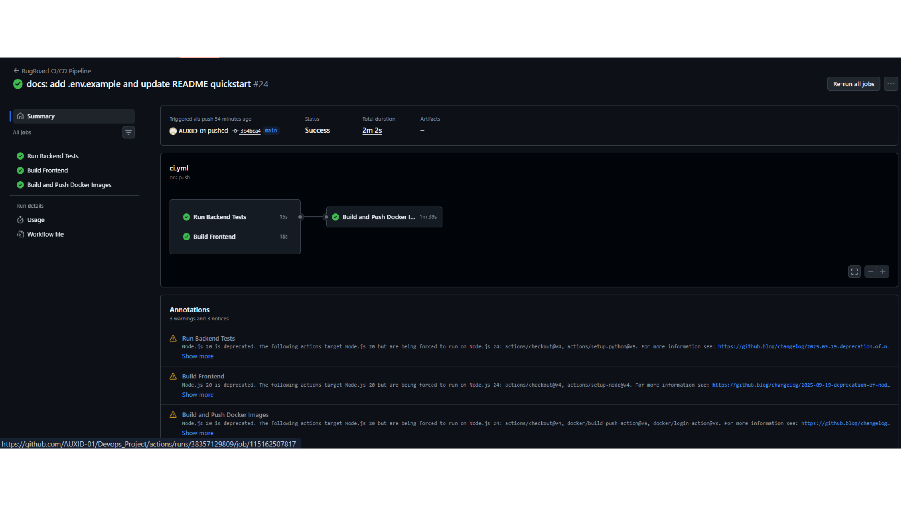
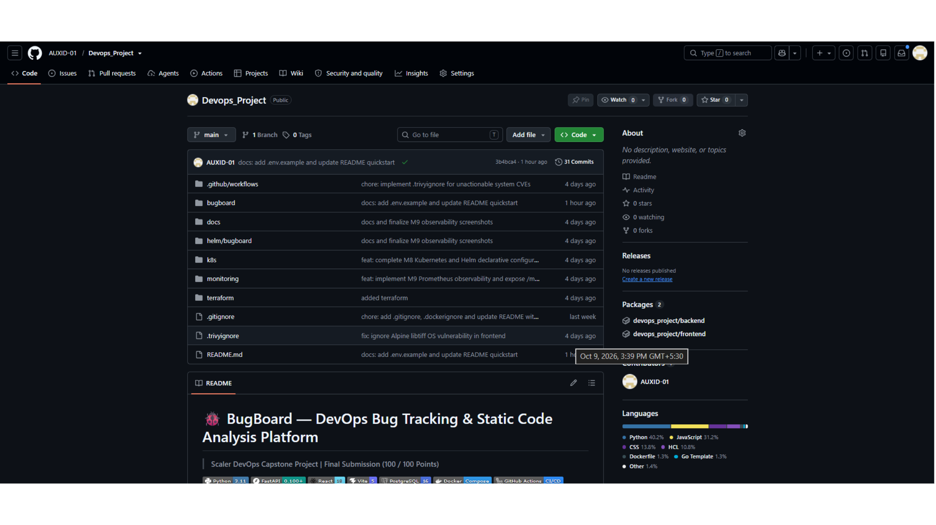
CASE NO. PL - 0426
QUALITY GATES
Automated quality gates keep broken code out of production
CI/CD PIPELINE
REPOSITORY STRUCTURE
Pytest → frontend build → Docker build → Trivy scan → registry push
Monorepo separates application, infrastructure, orchestration, monitoring, and docs.
All jobs passed successfully in the supplied run.
PROJECT LEDGER
PUBLIC INTEREST REPORT
05 / 08

Slide 6
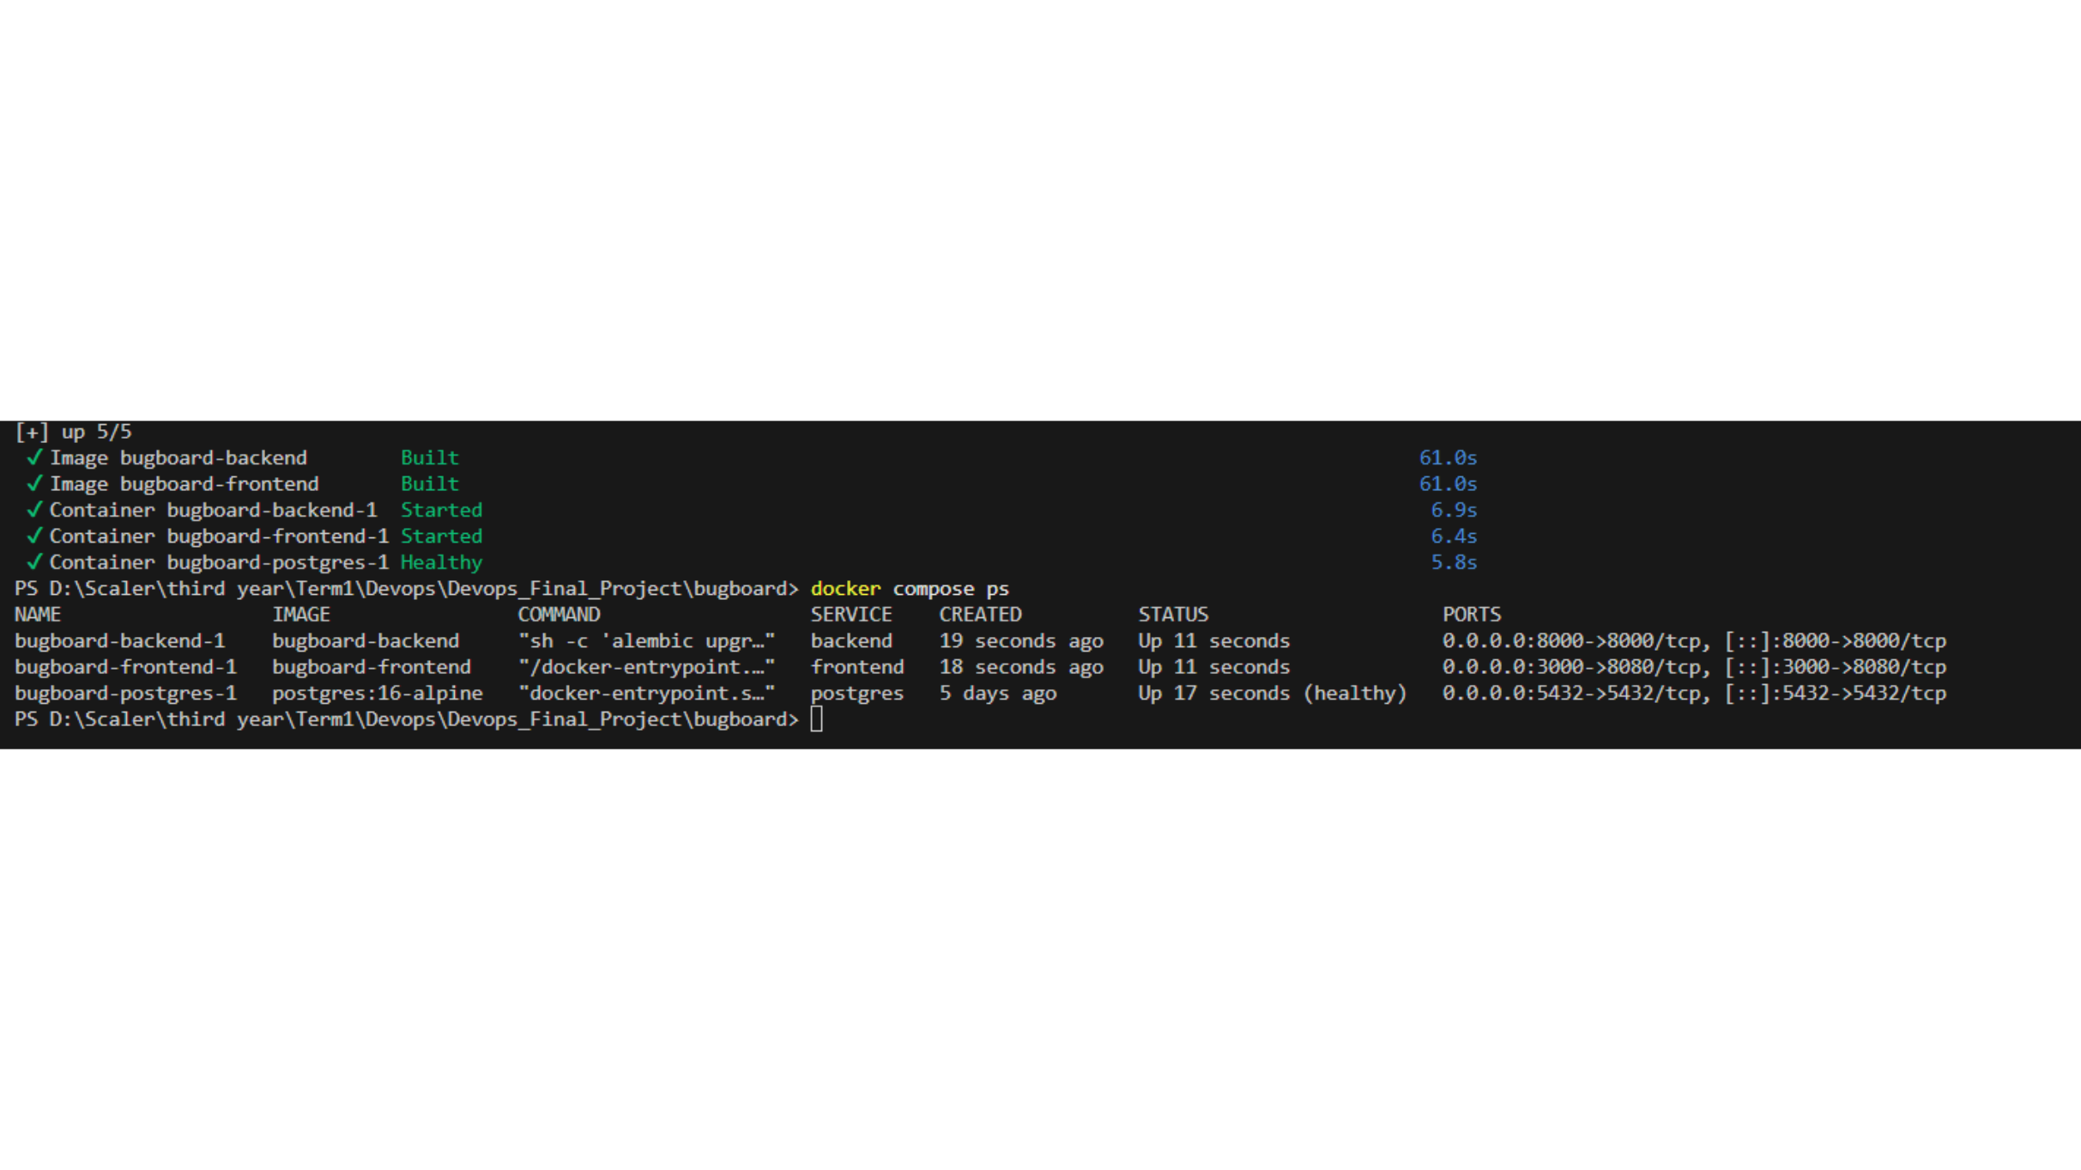
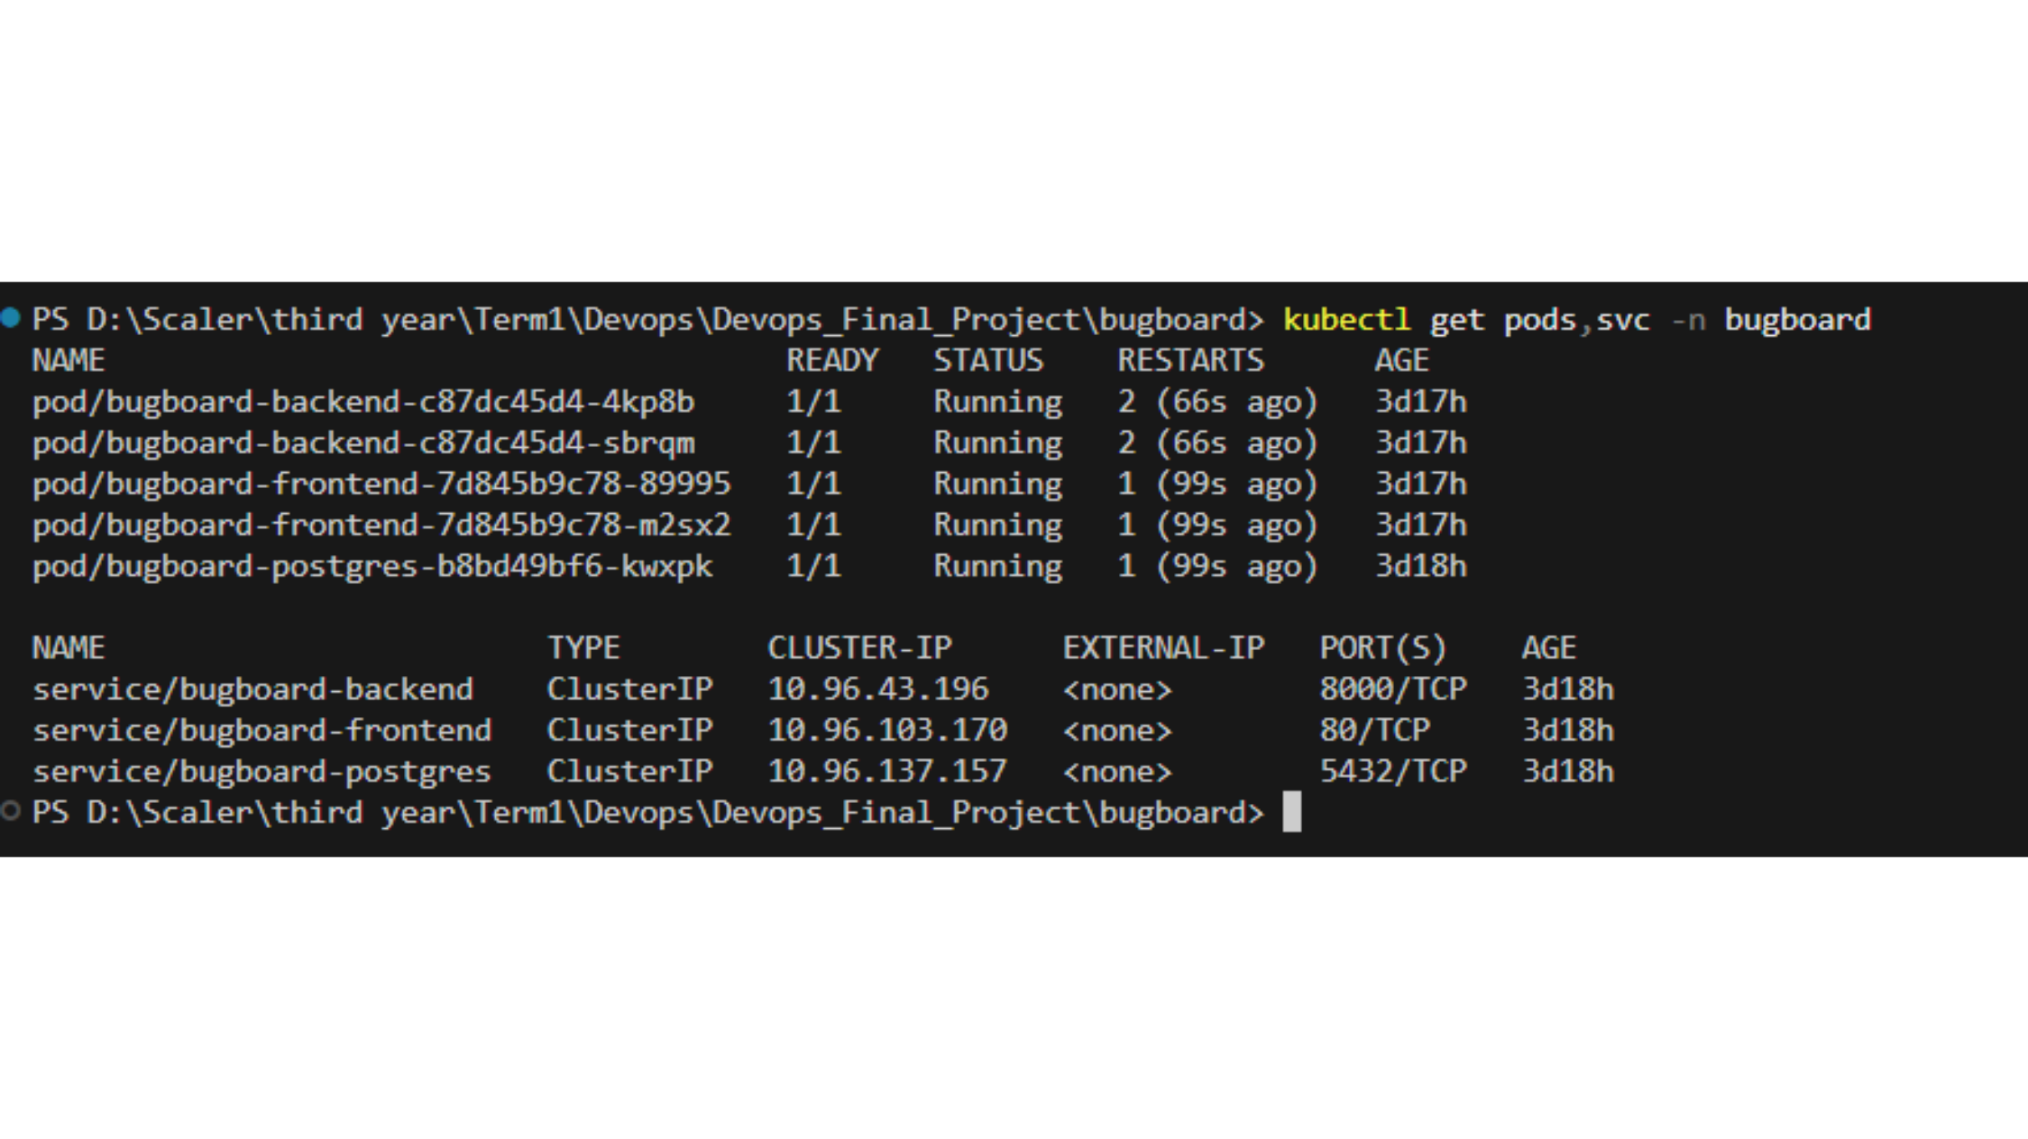
CASE NO. PL - 0426
RUNTIME EVIDENCE
One command boots local development; Kubernetes stays healthy
DOCKER COMPOSE
KUBERNETES CLUSTER
Frontend, backend, and PostgreSQL containers start together.
Backend, frontend, and PostgreSQL pods are Running in the bugboard namespace.
All services report healthy or running in the supplied terminal capture.
PROJECT LEDGER
PUBLIC INTEREST REPORT
06 / 08

Slide 7



CASE NO. PL - 0426
VISIBLE OUTCOMES
BugBoard turns DevOps discipline into visible outcomes
Zero broken deployments
Shift-left security
Instant observability
Trivy blocks HIGH and CRITICAL vulnerabilities before publishing.
Grafana surfaces traffic, P95 latency, and 5xx error rates.
Automated quality gates block unverified code.
PROJECT LEDGER
PUBLIC INTEREST REPORT
07 / 08

Slide 8
CASE NO. PL - 0426
THE TAKEAWAY
Velocity and deployment safety
can reinforce each other
Complete lifecycle: commit → tested → scanned → containerized → deployed → monitored
10 modules and a production-grade infrastructure capstone.
“BugBoard proves that developer velocity and deployment safety are not trade-offs — they’re complementary.”
Next: live demo walkthrough / evaluator Q&A · github.com/AUXID-01/Devops_Project
PROJECT LEDGER
PUBLIC INTEREST REPORT
08 / 08

